Slide 1
Socket Programming
Mini Chat
Team Members:
Zhuojun He
Swetha Govindu
Professor:
Hao Yue

Slide 2
Outline of the Presentation
Background
Motivation
Goals
Methods & Results
Demo
Learning Reflection

Slide 3
Background
Socket communication is a technology for exchanging data between two networked computers.
Socket agreement define how computers receive or send data through Internet.
Learning sockets is one of the way of learning how computers communicate each other.

Slide 4
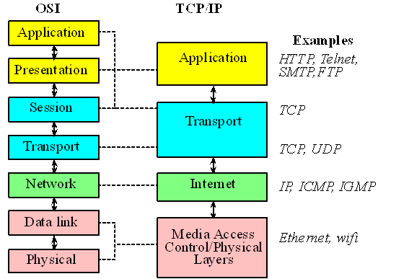
Layers structure of interconnection model.
OSI vs. TCP/IP

Slide 5
OSI vs. TCP/IP
OSI, open system interconnection model is only a conceptual and theoretical model.
There are too many layers in OSI model, which increases the complexity of network work
OSI is not largely apply in the world.
TCP/IP model is the advance socket model simplify from OSI.
The most commonly use network model today is the TCP/IP protocol.

Slide 6
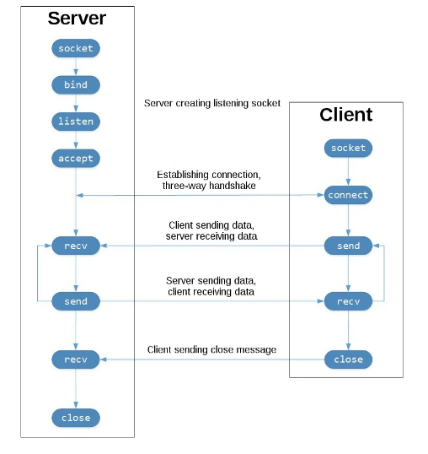
Major functions in TCP/IP model.

Slide 7
Major functions in TCP/IP socket program.
socket() is used to create an socket object which define what kind of socket family object you want.
bind() is used to pair the server/IP address and the port in the socket.
listen() is used by server to wait for connections from remote devices.
accept() is used by server for accepting, and completing the connection from the client.

Slide 8
Major functions in socket program.
connect() is very similar to accept() in server, which is used by client to connect any open server.
send() / write() is aim for sending data to the remote device.
recv() / read() is aim for receiving data from the remote device.
close() is use for terminating the connection in respect for the socket.

Slide 9
Motivation
A typical application of socket program is a chatting app.
We will learn to use TCP/IP methods by create a chatting app from draft.
To provide simple and common interface to send and receive data using socket programming.

Slide 10
Scenario & Use case
A typical application of socket program is a chatting app.
Case 1: Server & Client.
Authentication process between server and client.
Case 2: Client & Client.
Message / data exchange between clients.

Slide 11
Goals & Requirements
To create a chatting app is the final goal of our project.
Server should be able to verify the connection/login from the clients
Clients is able to send and receive message through the server mailbox.
Clients is able to instant chat with each other locally.

Slide 12
Method s & Results
Connect to the server
Get the user list
Send a message
Get my messages
Initiate a chat with my friend
Chat with my friend
Connect to gmail server
Disconnect
Notes:
Focussed on three types of communication→ offline,

Slide 13
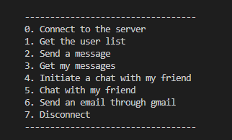
Method s & Results
Connect to the server
Get the user list
Send a message
Get my messages
Initiate a chat with my friend
Chat with my friend
Connect to gmail server
Disconnect

Slide 14
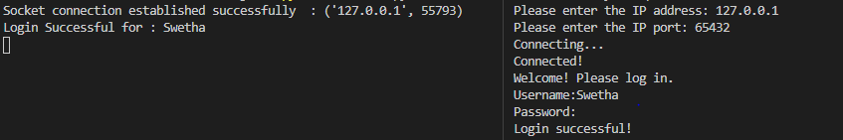
Socket Connection
Establishes connection between client and server.
Handles authentication between the client and server.
It takes username and password for authentication.
Notes:
Server runs on a specific computer and has a socket that is bound to a specific port number. The client knows the hostname of the machine on which the server is running and the port number on which the server is listening
The server just waits, listening to the socket for a client to make a connection request.
On the client side, if the connection is accepted, a socket is successfully created and the client can use the socket to communicate with the server.

Slide 15
Method s & Results
Connect to the server
Get the user list
Send a message
Get my messages
Initiate a chat with my friend
Chat with my friend
Connect to gmail server
Disconnect

Slide 16
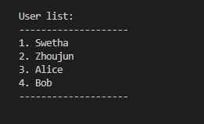
Get all users list in the server
This method returns all the users from the server.
Logged in user can communicate with any user from the user list.
Notes:
Server has user details stored in a flat database.

Slide 17
Method s & Results
Connect to the server
Get the user list
Send a message
Get my messages
Initiate a chat with my friend
Chat with my friend
Connect to gmail server
Disconnect

Slide 18
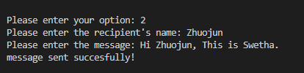
Send a Message
Logged in users enters recipient’s user name and message to send.
Server receives the message from the client and acknowledges/responds to the client that the message was received successfully.

Slide 19
Method s & Results
Connect to the server
Get the user list
Send a message
Get my messages
Initiate a chat with my friend
Chat with my friend
Connect to gmail server
Disconnect

Slide 20
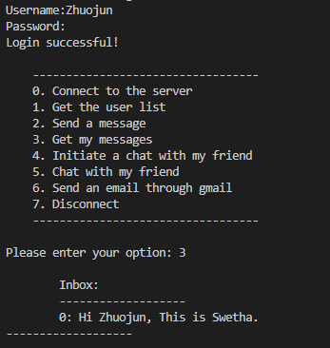
Get Messages
Logged in user can view all the received messages.

Slide 21
Method s & Results
Connect to the server
Get the user list
Send a message
Get my messages
Initiate a chat with my friend
Chat with my friend
Connect to gmail server
Disconnect

Slide 22
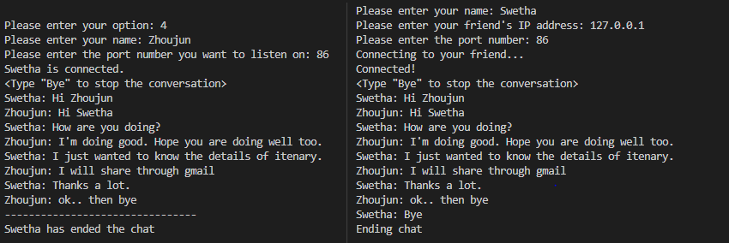
Initiate a chat with my friend & chat with my friend
The communication is live and two way. Each message sent from one user is received through socket by the other user.
The communication can be terminated any time by either user.

Slide 23
Method s & Results
Connect to the server
Get the user list
Send a message
Get my messages
Initiate a chat with my friend
Chat with my friend
Connect to gmail server
Disconnect

Slide 24
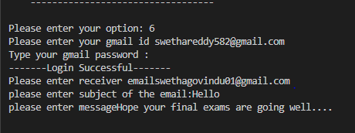
Connecting to Gmail Server
Connects directly to gmail server from local client through smtp protocol.
Message has been sent to receiver gmail after successful authentication of sender’s gmail credentials.

Slide 25
Python Libraries
Socket
GetPass
SMTPLIB

Slide 26
Demo
Github link: https://github.com/swetha867/Chat-App

Slide 27


Slide 28
Challenges
Apply and test our chatting app online instead of locally.
Reconnect issue. Clients are unable to reconnect if they don’t log out properly.
Connecting to gmail server through local client.

Slide 29
Learning Reflection
We gained better insight about concepts, methods about socket programming.
We practised to apply some basic TCP/IP methods to develop a simple chatting app by using python.
Communication is the key which make the project success.
Project success correlates with team cohesion

Slide 30
Question & Answer
Thank you

